Slide 1
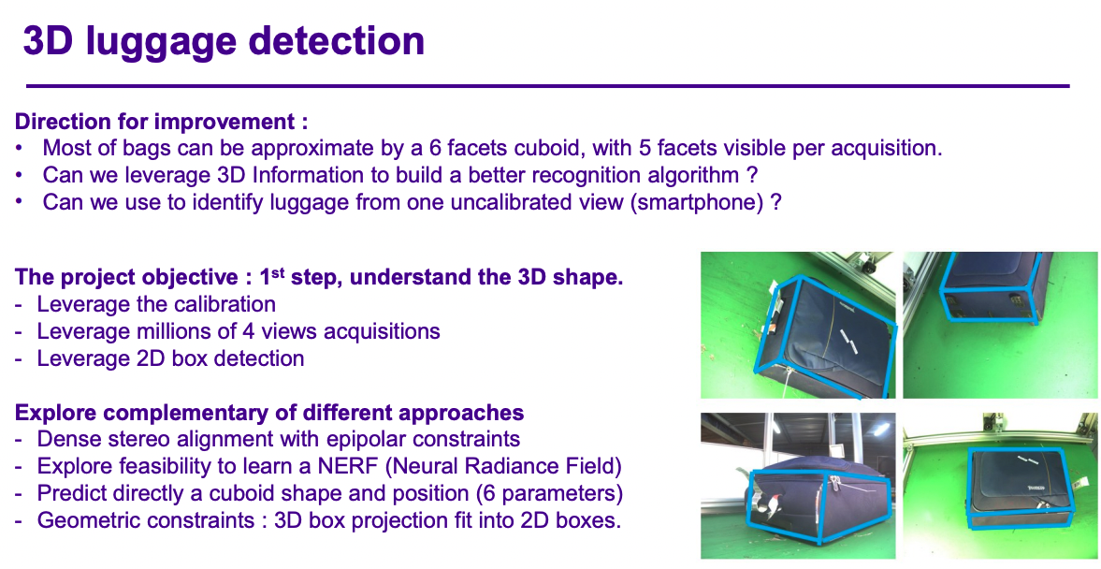


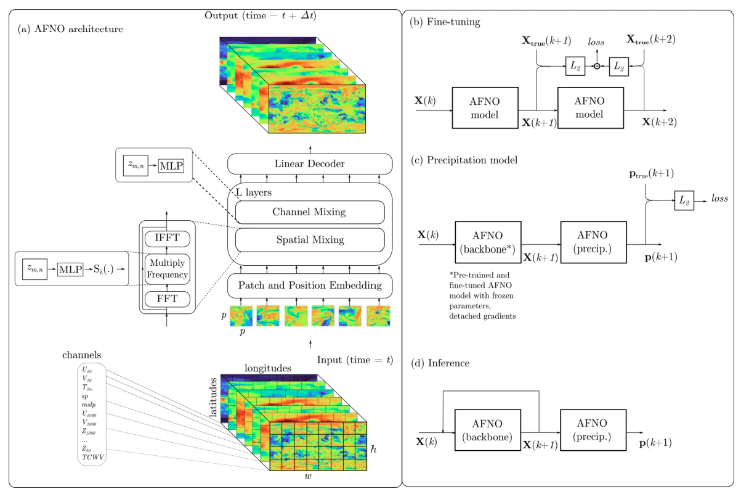

Heyuan LIU
Ongoing Projects
3D Luggage Detection
for Lost Packages in Airport
Industrial Research Project
Sept. 2024 to Mar. 2025
AI for Wild-Fire and Extreme Weather Prediction
Research Project
Inspired from FourCastNet and GraphCast,
Find out solutions in GNN, PINN.
Examples in FourCastNet from Nvidia

Slide 2

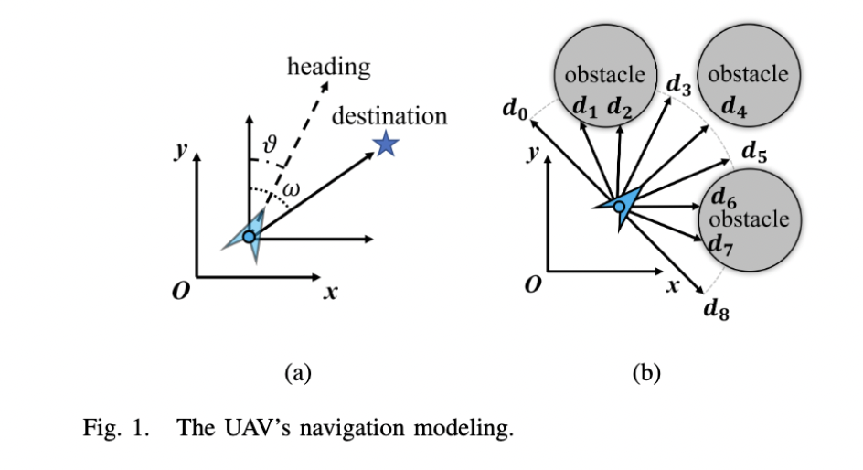

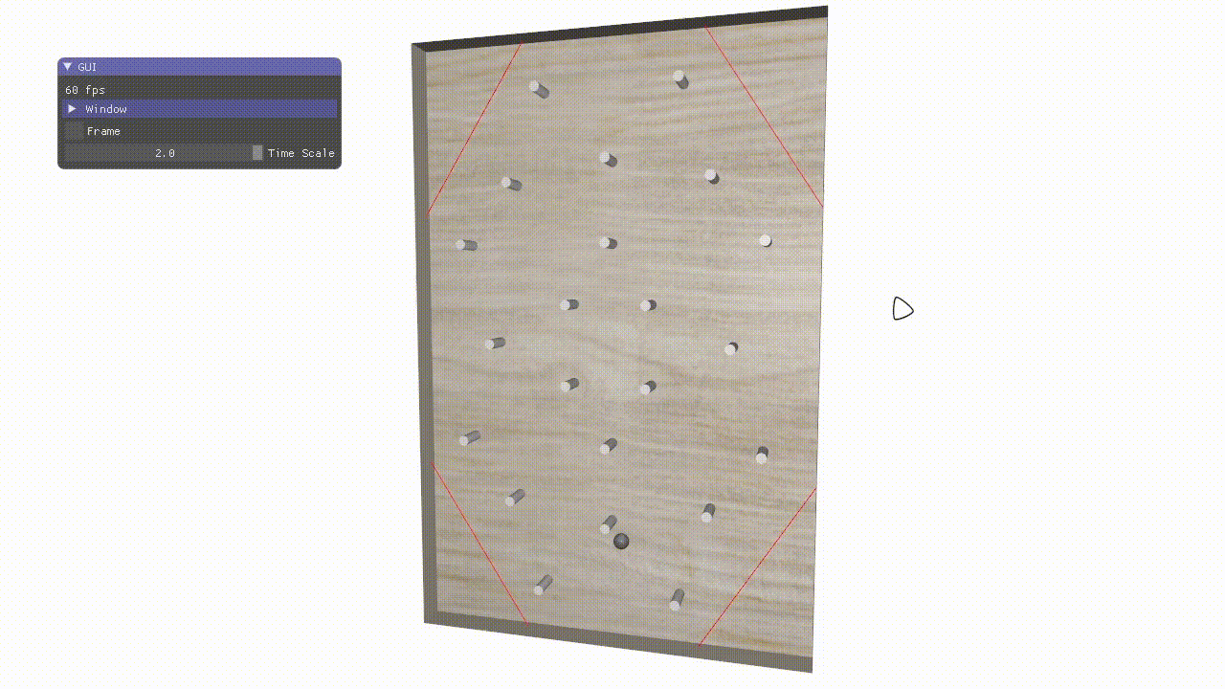
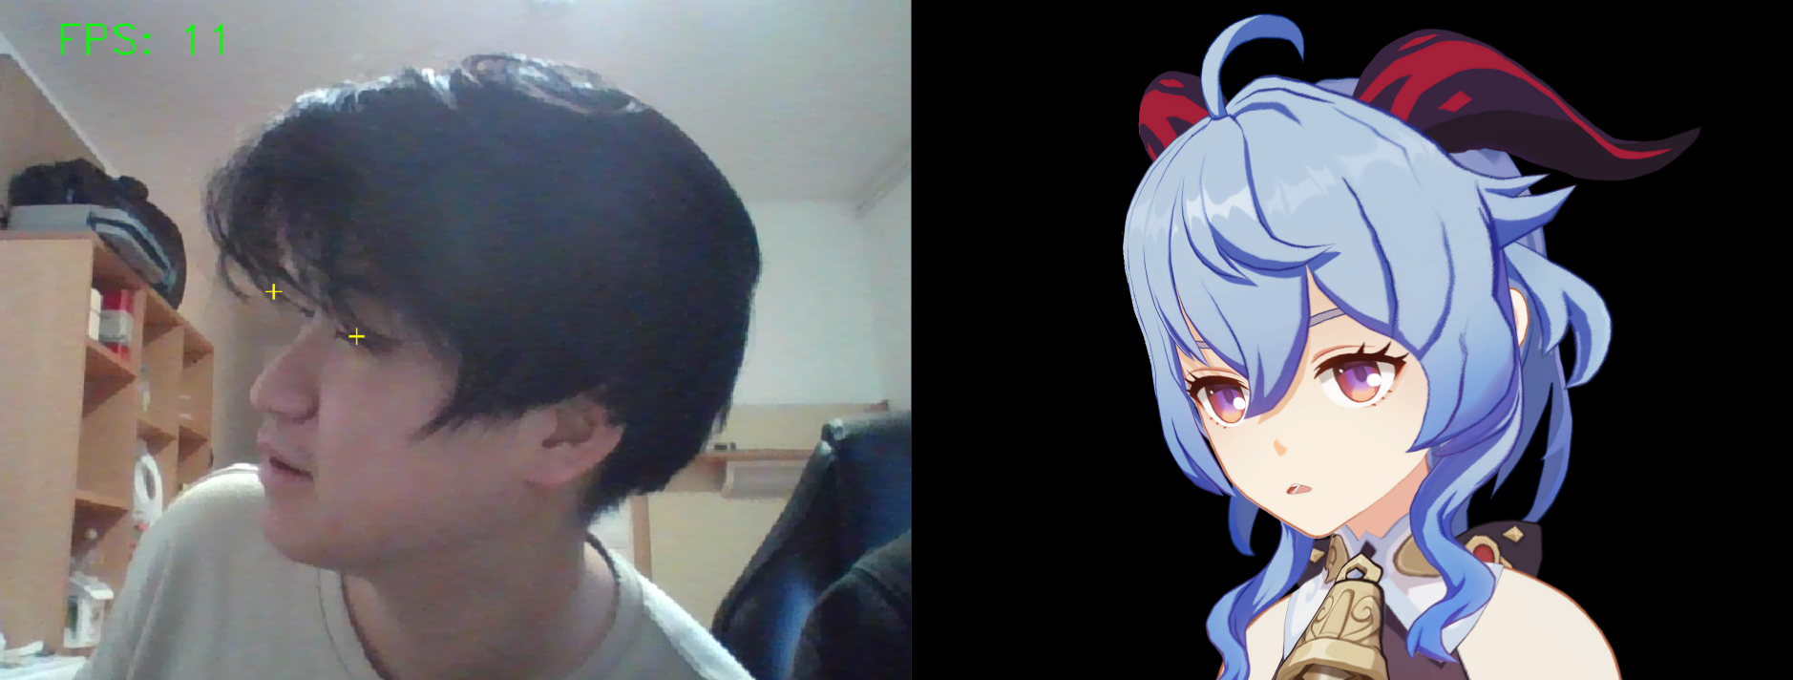
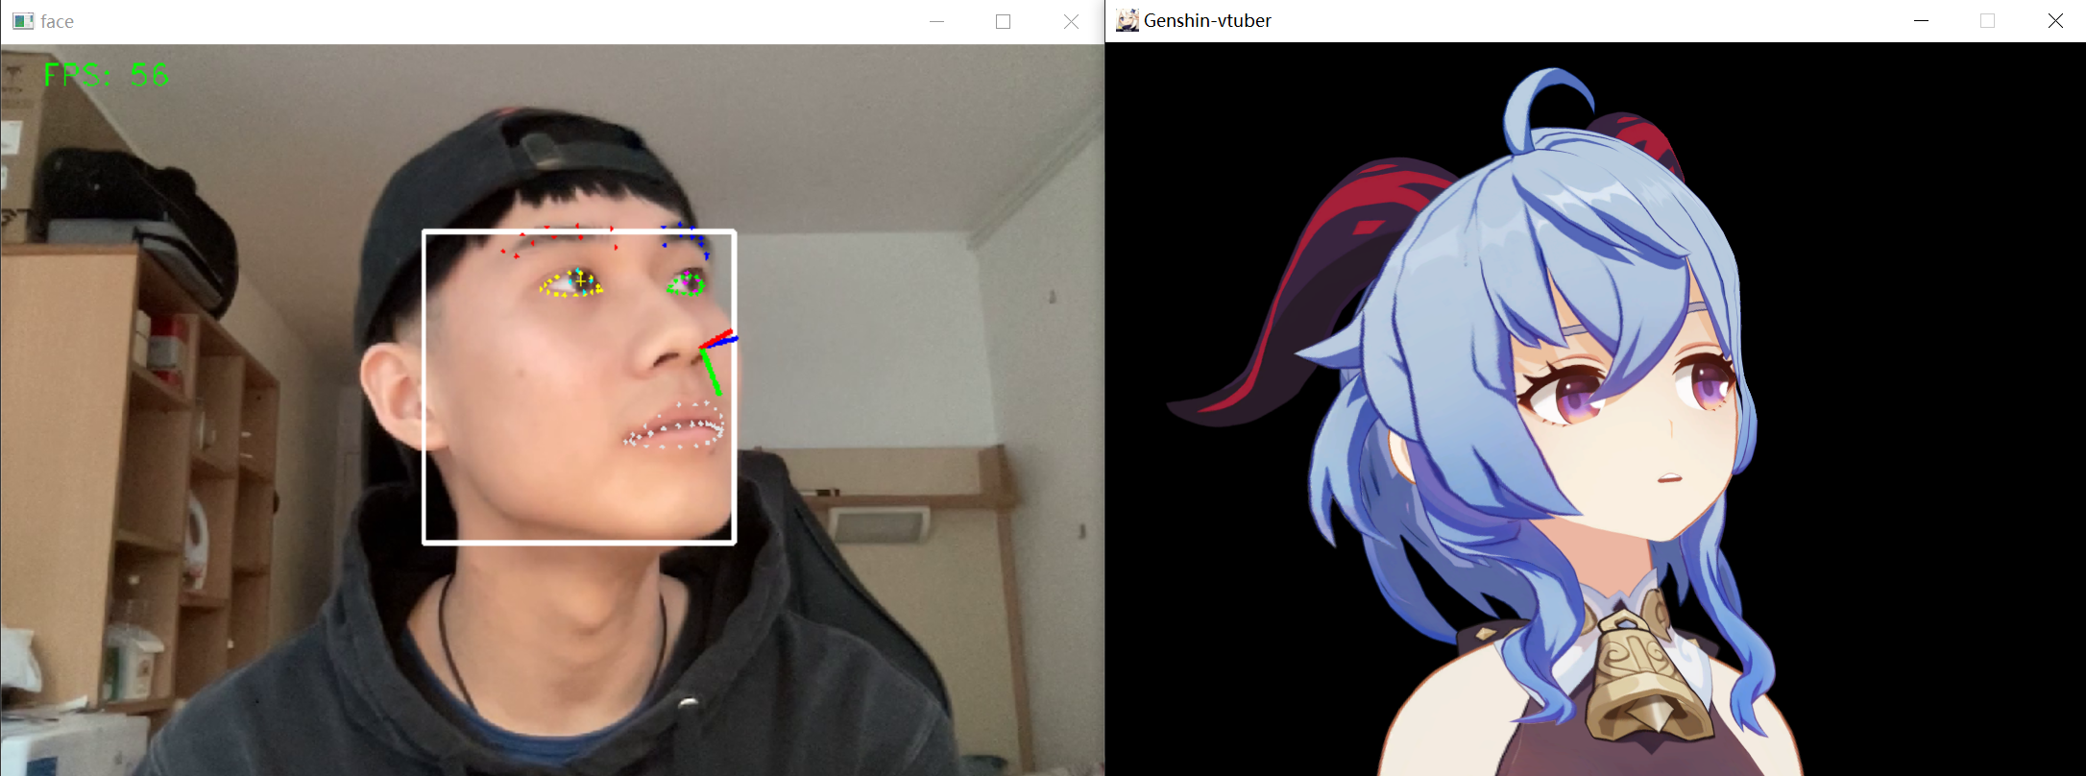
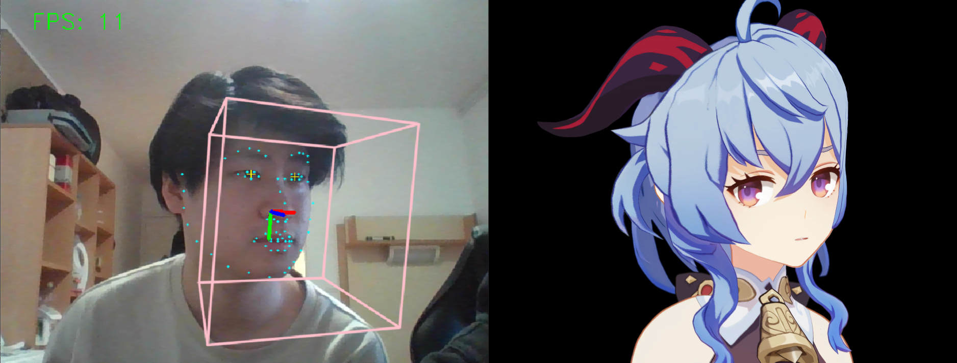
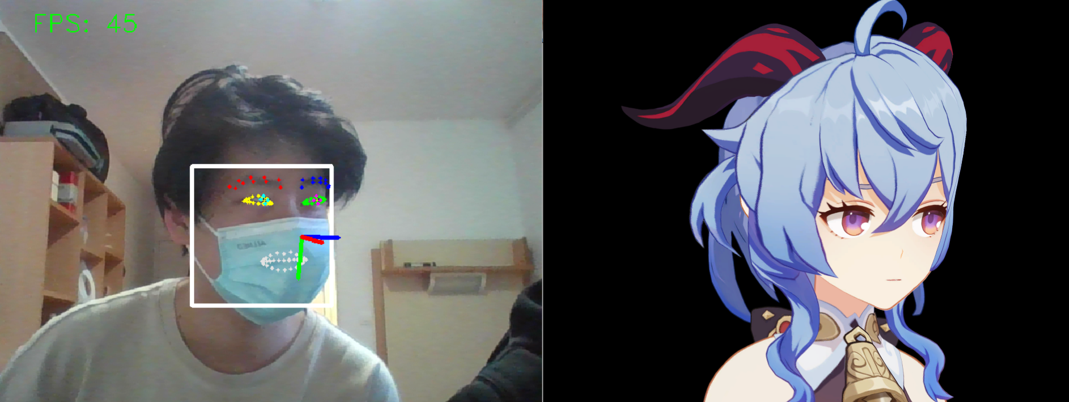
École Polytechnique
Projects in M1
Multiple AI & CS techniques Could be useful
Heyuan LIU
MSc&T AiViC
Extractive Summarization with Discourse Graphs
Navi-UAV
Deep Learning
NLP
Drones Control with 0 Violations
In Complex Environment
Graph Neural Network
Data:
420 Conversations with architectures and Context
Mission:
Identify the important statements
Link: https://github.com/MiSFiT5/INF554_Project
Drones Control
Reinforcement Learning
DDPG
Link: https://github.com/172698691/INF581-Project
Vtuber-Genshin
Precision Collision Dynamics Simulation in Pinball
Computer Vision
Computer Animation
Physics Simulation in 3D Graphics
Face Tracker
Link: https://github.com/MiSFiT5/INF554_Project
Link: https://github.com/172698691/INF-585/tree/main/inf585_lab_code/scenes_inf585/project
(Private now)

Slide 3

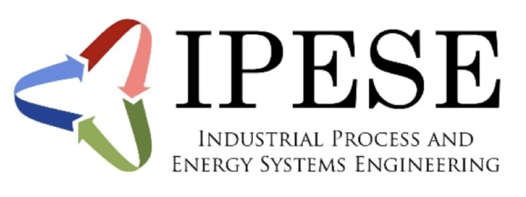
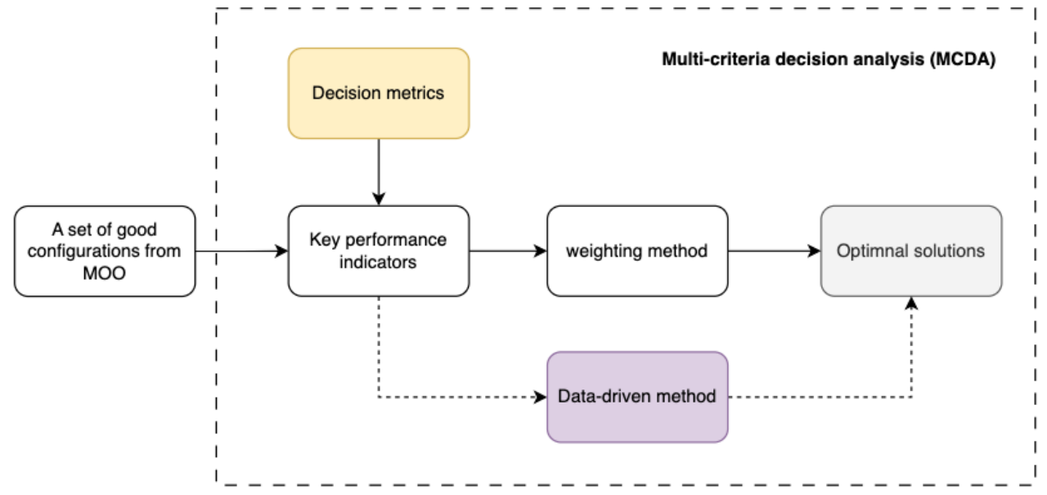
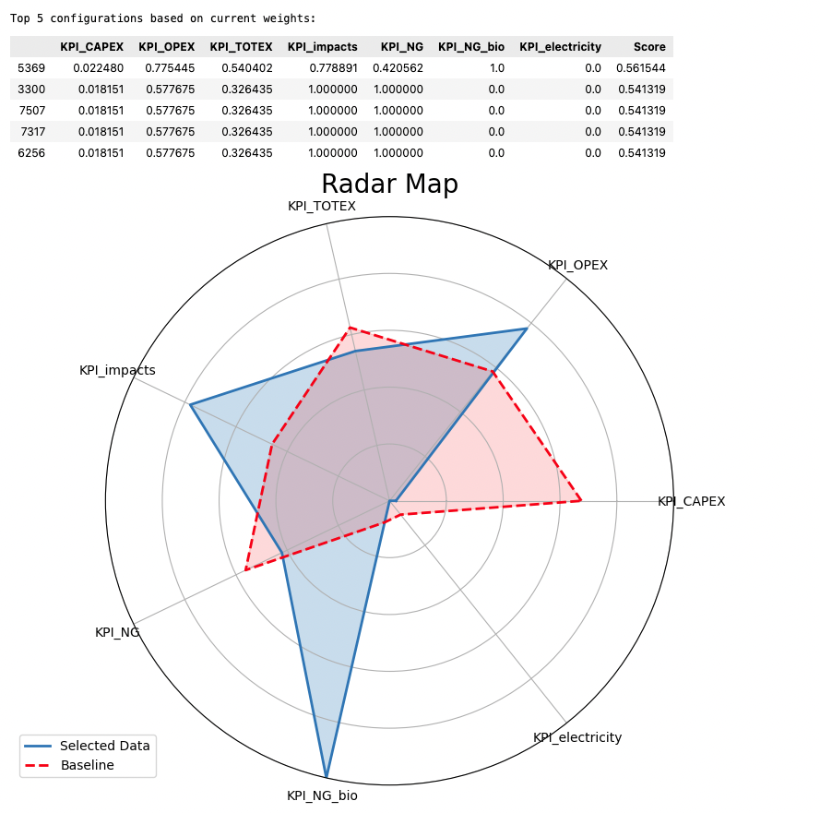
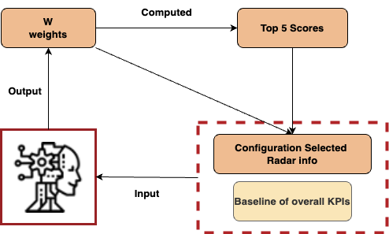
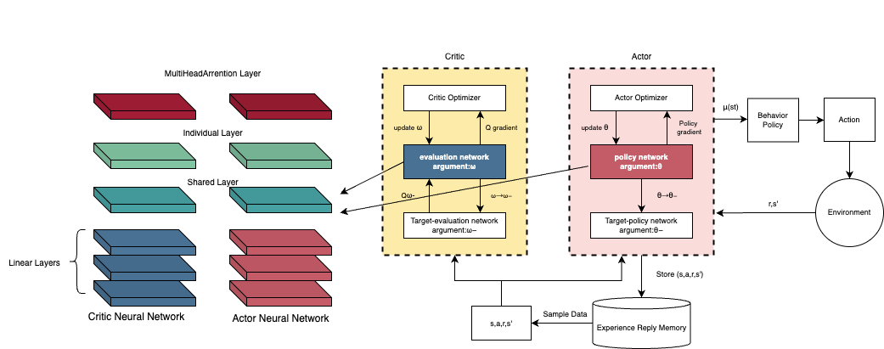
Heyuan LIU
Research Internship
Identify optimal configuration with a machine learning method in multi-criteria decision analysis
1. Identify the Typical Configurations (data-driven)
from the Optimal Configurations on pareto front
2. Self-Iterative LLM agents for configuration selection with preferneces
3. Reinforcement Learning with Multi-Objectives and uncertain Market conditions
3

